Slide 1
Welcome to the Officers of Administration Council Annual Meeting 2013

Slide 3
Officers of Administration
Annual Meeting
Agenda
Welcome and Introduction of OA Council Miriam Bolton
Report on 2012-13 Council Accomplishments and Goals Miriam Bolton
2013-14 OA Forums Colleen McKillip
Remarks & QA with VP for Finance and Administration Jamie Moffitt
Remarks & QA from Senate President Margie Paris
Q&A with OAC OA Council
Adjourn for Networking

Slide 4
OAC Mission
Our mission is to build community among the UO’s diverse range of professionals and to support this community by facilitating communication, identifying and addressing pertinent issues, acting as a liaison with central administration, raising the professional profile of OAs, and creating opportunities for collegiality.

Slide 5
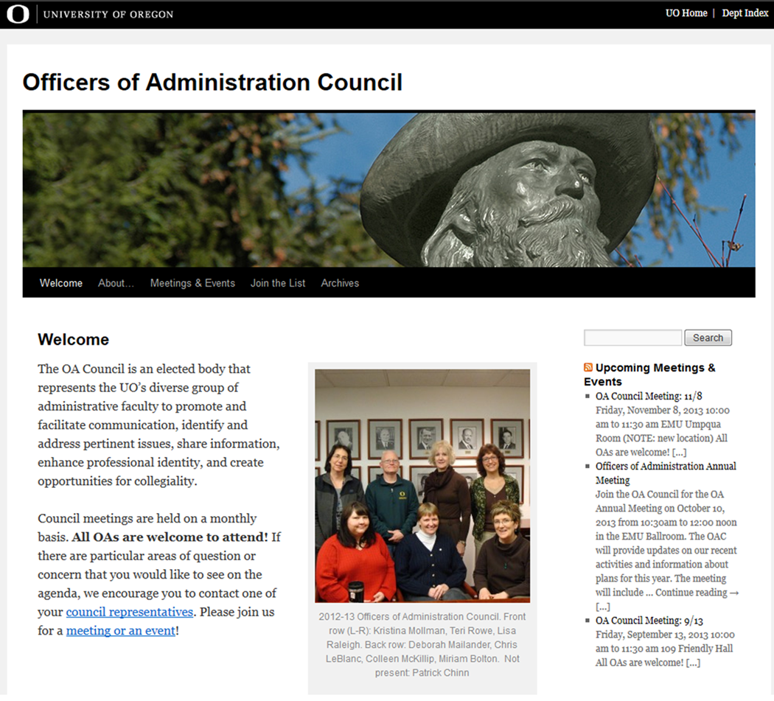
2012-13 Accomplishments
Website update

Slide 6
2012-13 Accomplishments
Meetings with senior university leadership
President Gottfredson
Vice President Jamie Moffitt
Vice President Yvette Alex-Assensoh
Chief Information Officer Melissa Woo
We also met with Greg Stripp, Ruth Keele, Kathy Warden and Linda King regarding improving the process around policy development and implementation.

Slide 7
2012-13 Accomplishments
Partnered with Human Resources and Organizational Development and Training for professional development opportunity
“Emotional Intelligence...How the Best Leaders Build, Maintain,
and Even Restore Trust in Times of Change”
Lead by Suzanne Rotondo

Slide 8
“Employees around the world have expectations for professional development. Ultimate responsibility for career development rests with the employee. It is up to him or her to take advantage of the opportunities offered.”
From a 2011 Hay Group survey of four million employees globally

Slide 9
2012-13 Accomplishments
OA Forums and Ice Cream Social (More on this later)
OAC Annual Retreat

Slide 10
Looking forward to 2013-14
Listening Tours
More opportunities for OA Engagement
Continue building relationships with UO administration and senate
Begin relationship with governing board members
Increase communication and share information

Slide 11
“Whatever you do will be insignificant, but it is very important that you do it.”
Mahatma Gandhi

